Slide 1



Slide 2
Introduction to programming in R
From the beginning to functions.

Slide 3
Where we are going …
What the computer is doing
Using it like a calculator
Simple data
Simple code
Letting the code make decisions
Computers are really good at doing things over and over again
Complex data
Custom Functions

Slide 4
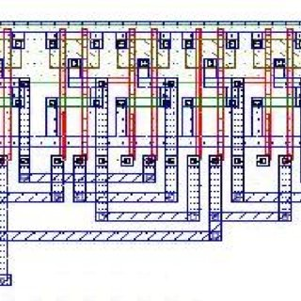
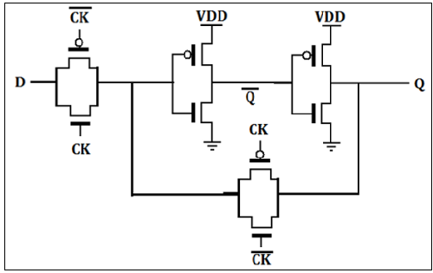
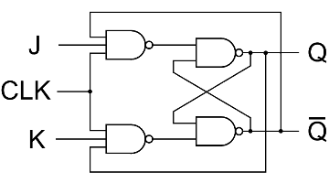
1. What the computer is doing

Slide 5
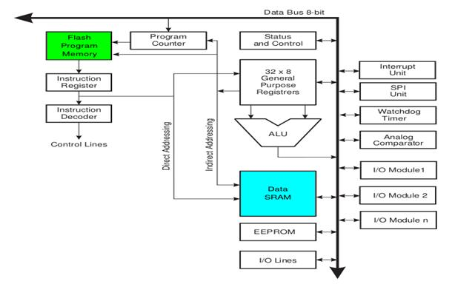
1. What the computer is doing

Slide 6
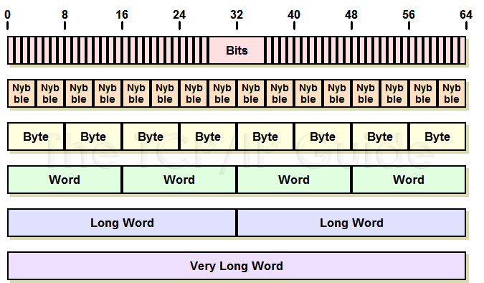
1. What the computer is doing
0 0 1 0 0 1 1 0 0 1 0 1 1 1 1 0
0010 0110 0101 1110
2 6 5 e
00100110 01011110
26 5e
"." "X"
0010111001011000
265e
"♞"

Slide 7
1. What the computer is doing
0 0 0 0 0 1 0 0 1 1 0 0 1 0 1 0
0000 0100 1100 1010
0 4 c a
00001000 11001010
04 ca
ADD AL,ib ib
0000010011001010
04ca
AL <- AL + ca

Slide 8
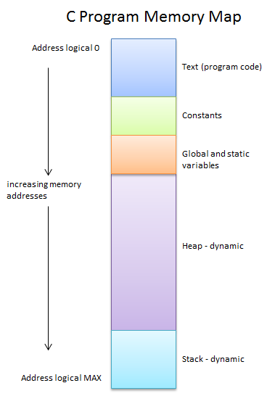
1. What the computer is doing
generate_the_cohort_table()
plot_survival()
data.frame()
cohort_table
blood_test_results
list_of_infected_patients
http://faculty.washington.edu/gmobus/Academics/TCES202

Slide 9
1. What the computer is doing
Everything in the end is stored in memory as binary data.
We are interested in two things:
1. Data
2. Doing things to the data – instructions, operations, commands, functions …
noun – a thing e.g. patients, survival_data
verb – a doing e.g. open_file(), plot_survival()

Slide 10
1. What the computer is doing
generate_the_cohort_table()
plot_survival()
data.frame()
cohort_table
blood_test_results
list_of_infected_patients
operations
code
functions
variables
constants
data
http://faculty.washington.edu/gmobus/Academics/TCES202

Slide 11
2. Using R like a calculator
R is an interpreted language so you can get it to execute code immediately.
We can work in R just like having a calculator.
In the console, type in a number, ‘+’ and another number and press enter.
3 + 4 [enter]
[1] 7
Try others such as ‘*’, ‘-’, ‘/’, ‘%%’, ‘**’, ‘^’.
Try combinations 3 + 4 * 7 (use brackets to counter precedence rules).

Slide 12
2. Using R like a calculator
There are some special values in R:
NA No data (length 1)
Inf Infinity (e.g. 1/0)
-Inf Minus infinity (e.g. -1/0)
NaN Not a number (e.g. 0/0)
NULL An empty value (length 0)

Slide 13
2. Using R like a calculator
But once the interpreter has displayed the result, it forgets it.
So we need to save it to memory which simply means giving it a name.
We do this with:
answer <- 3 + 4
And we can get the interpreter to show us the value of answer with:
answer
print(answer)
noun – a thing e.g. patients, survival_data

Slide 14
2. Using R like a calculator
And now, we can use our saved answer in further operations:
answer <- answer + 7
answer
Or create a new variable:
result <- answer ** 2
result

Slide 15
3. Simple data
There are several simple types of data (ways to interpret the ones and zeroes):
strings <- "This is a piece of text.\n"
integers <- 170
numbers <- 3.1415926
logicals <- TRUE | FALSE

Slide 16
3. Simple data
What happens if you try to mix different kinds of data?
result <- 170L + 0.5
result <- 170 + "a"
result <- 170 + TRUE

Slide 17
3. Simple data
Changing the data type.
Sometimes we need to convert data from one format into another:
From a character to a number:
number <- as.numeric("120")
number <- as.numeric("-0.07891")

Slide 18
3. Simple data
Changing the data type.
Sometimes we need to convert data from one format into another:
From a character to an integer:
integer <- as.integer("-90")
integer <- as.integer(11.6165)
Note:
rounded <- round(11.6165, 2)

Slide 19
3. Simple data
Changing the data type.
string <- as.character(77.37782)
string <- as.character(sqrt(99))
date <- as.Date("2021-01-18")

Slide 20
4. Simple code
Functions:
print(result)
cat("The result is", result)
cat("The result is", result, ".\n", sep=" ")
Checking the data type:
class(result)
str(result)

Slide 21
4. Simple code
Other functions (see e.g. https://www.statmethods.net/management/functions.html):
sqrt(100) # Square root.
log(100) # natural log (also log10()).
substr("contents", 4, 7) # Substring.
toupper("contents") # Convert to UPPERCASE.
runif(1) # Generate a random number.
seq(1, 10, 3) # Sequence 1, 4, 7, 10

Slide 22
5. Letting the code make decisions
The code will sometimes need to perform certain operations depending on the value of the data, i.e. if the data is within a specified range of values:
if (condition) a_function()
e.g.
if (result > 0) print(result)
What happens if result is 10 and if result is -10?

Slide 23
5. Letting the code make decisions
Other conditions:
> greater than
>= greater than or equals
== equals (NB This is not "=").
<= less than or equals
< less than
!= is not equal to

Slide 24
5. Letting the code make decisions
Try out some conditions, if x <- 3; y <- 9, what is:
x > y ?
y > x ?
x >= 3 ?
x == y ?
x <= 3 ?
x+y < 10 ?
x != y^2 ?

Slide 25
5. Letting the code make decisions
Logical combinations:
| or a | b is TRUE if TRUE OR b is TRUE or both are
& and a & b is TRUE if a is TRUE AND b is TRUE
! not !a is TRUE if a is FALSE
|| or same as |, but only refers to the first element
&& and same as &, but only refers to the first element

Slide 26
5. Letting the code make decisions
So how would we write:
x is 3 and y is 9?
x is not equal to 3 and y is less than 9?
x is less than 3 or greater than 11?
y and y are greater than 10?
x is greater than or equal to 3 and less than or equal to 11?

Slide 27
5. Letting the code make decisions
Special characters need special functions to check for equality:
is.na() is the value an NA
is.nan() is the value an NaN
is.infinite() is the value +/-Inf
NA always results in NA, so if result is NA, result == NA isn’t TRUE but NA. This will be important later for statistics and you may need to ignore NAs in the calculation of means by removing them using:
mean(x, na.rm=TRUE)

Slide 28
5. Using R in Scripts
Now is a good time to create a working project if you haven’t already done so and open an R script file.
Create a new project in a working directory e.g. ~/HDS/R_Projects
Give the project a name (the directory name) e.g. Learning
Check “create a git repository” and “open in a new session”
Add a new R script (File > New file > R script) e.g. learning.R

Slide 29
5. Letting the code make decisions
Assign a value to a variable e.g. name.
Write some code to display a confirmation message if name equals that value.
Modify the code to confirm if the name is one of two values.
Modify the code to confirm if another variable, which is numeric, say, number is greater than 0 (as well as the above conditions).
Run the code using the “Source” button (top right of the Script panel).

Slide 30
5. Letting the code make decisions
If you want to do more than one thing if the condition is met, use curly braces { and } to contain the code:
if ((name=="Pete") | (name=="Tac")) {
print("Hi!")
name <- paste("[", name, "]")
}

Slide 31
5. Letting the code make decisions
If you want to do something when the condition isn’t TRUE as well, you can use else:
if (condition) {
do_something()
} else {
do_something_else()
}

Slide 32
5. Letting the code make decisions
Modify your code to display a confirmation message for either name and a warning message otherwise.
Modify your code to display a confirmation message if the numeric value is greater than zero, a message if it is equal to zero and a different message if less than zero.

Slide 33
5. Letting the code make decisions
A couple of useful extras:
cat() can be used to display more complex messages, for example,
cat(“Hello”, name, “\n”)
will display, “Hello Pete” and then a newline (that’s the “\n”).
You can disable a line of code using the comment symbol “#”.
# print(“Hello, Pete”)
won‘t do anything.
Also note the difference in output between print() and cat().

Slide 34
5. Letting the code make decisions
Back to the questions …
Modify your code to display a confirmation message for either name and a warning message otherwise.
Modify your code to display a confirmation message if the numeric value is greater than zero, a message if it is equal to zero and a different message if less than zero.

Slide 35
6. Doing things over and over again
Repeating yourself – going round in loops.
There are several types:
for-loops - if you know how many times you want to loop
while-loops - if you want to keep going until something happens
repeat-loops- if you don’t want to check at the start

Slide 36
6. Doing things over and over again
For-loops:
for (<condition defining a loop variable>) {
do_something()
}
e.g.
for (i in 1:10) {
cat(i, "\n")
}

Slide 37
6. Doing things over and over again
While-loops:
while (<condition>) {
do_something()
}
e.g.
i <- 1
while (i < 10) {
cat(i, "\n")
i <- i + 1
}

Slide 38
6. Doing things over and over again
Repeat-loops:
repeat {
do_something()
if (<condition>) break
}
e.g.
i <- 1
repeat {
cat(i, "\n")
i <- i + 1
if (i > 10) break
}

Slide 39
6. Doing things over and over again
Exercise:
Choose different loop structures to do the following:
Display the 12 times table.
Bonus: how would you display all the times tables from 2 – 12?
Display random numbers until you get a value < 0.1 or have 10 random numbers whichever happens first.
A random number can be calculated with: runif(1)
Display dice rolls (2 dice) until you get a pair that adds to 7.
Dice roll can be calculated with: as.integer(runif(1)*6 + 1)

Slide 40
7. Complex data
Generally we use more complex data structures.
Vectors and Lists
Matrices and Arrays
Naming
Accessing components
Applying functions to components
Converting between types
Factors
Data frames

Slide 41
7. Complex data
Vectors
A list of elements of the same type e.g. 1 2 2 3 1 4
Create with combine function, c() e.g. v <- c(1, 2, 2, 3, 1, 4)
There are special functions:
sum(v)
length(v)
mean(v)
v ^ 2

Slide 42
7. Complex data
Vectors v <- c(1, 2, 2, 3, 1, 4)
Refer to items by index print(v[4]) 3
Set items the same way v[5] <- 10 1, 2, 2, 3, 10, 4
And add items v[7] <- -1 1, 2, 2, 3, 10, 4, -1
NA’s
mean(c(1, 2, 3, NA, 4, 5)) NA
mean(c(1, 2, 3, NA, 4, 5), na.rm=TRUE) 3

Slide 43
7. Complex data
Vectors v <- c(1, 2, 2, 3, 1, 4)
Get a subset v[c(1,2,3,5)] c(1, 2, 2, 1)
Use the which() function v[which(v<3)] c(1, 2, 2, 1)
Leave out an item v[-4] c(1, 2, 2, 1, 4)
Add vectors v <- v + v c(2, 4, 4, 6, 2, 8)
Append vectors v <- c(v, v) c(2, 4, 4, 6, 2, 8, 2, 4, 4, 6, 2, 8)
Apply a func to the elements sapply(v, sqrt) c(1.414, 2.000, …

Slide 44
7. Complex data
Lists
Elements of different types e.g. 1 0.1 "hello" c(2, 3)
Create with constructor, list() e.g. ls<-list(1,0.1,"hi",c(2,3))
(c() will coerce everything to string)
Access by index: ls[2] list(0.1)
Check with ls[2]+0.1 <error>
Get the actual value: ls[[2]] 0.1

Slide 45
7. Complex data
Converting between complex types
as.vector(), as.list(), as.matrix(), as.data.frame()
But to go from a list to a vector, use unlist()
Exercise:
Create a list from c(1, 2, 3, 4, 5), "six", 0.1
(try with c() and with list() and what do you get?)
Convert to a vector with as.vector() and unlist() and what do you get?

Slide 46
7. Complex data
Factors
Categorical values shown as strings but stored as indices e.g.
“smoker”, “non-smoker”, “smoker”, “unknown”, “non-smoker” etc.
(levels may be “smoker”=1, “non-smoker”=2 and “unknown”=3)
Stored as
1, 2, 1, 3, 2 …
smoking <- c("smoker", "non-smoker", "smoker", "unknown", "non-smoker")
[1] "smoker" "non-smoker" "smoker" "unknown" "non-smoker"
smoking <- as.factor(smoking)
[1] smoker non-smoker smoker unknown non-smoker
Levels: non-smoker smoker unknown

Slide 47
7. Complex data
Data Frames
df <- data.frame(
name=c('Olive', 'Pinochio', 'Queenie', 'Raphael'),
gender=c('female', 'male', 'female', 'male'),
height=c(1.7, 1.01, 1.3, 1.6),
weight=c(60, 30, 50, 40),
stringsAsFactors=FALSE)
df
name gender height weight
1 Olive female 1.70 60
2 Pinochio male 1.01 30
3 Queenie female 1.30 50
4 Raphael male 1.60 40

Slide 48
7. Complex data
Data Frames
Access a column by name with $, df$height [1] 1.70 1.01 1.30 1.60
Or df[, 'height'] [1] 1.70 1.01 1.30 1.60
Or index, df[3, ] [1] 1.70 1.01 1.30 1.60
And rows with df[, 2] 2 Pinochio male 1.01 30
Apply a function, mean(df[ , 3]) 1.4025
And to multiple columns,
sapply(df[, 3:4], mean) height: 1.4025, weight: 45
name gender height weight
1 Olive female 1.70 60
2 Pinochio male 1.01 30
3 Queenie female 1.30 50
4 Raphael male 1.60 40

Slide 49
7. Complex data
Data Frames
Add a row, rbind() newRow <- data.frame(name="Seren", …)
rbind(df, newRow)
Add a column, cbind() newCol <- data.frame(age=c(60, 6, 40, 19, 32))
cbind(df, newCol)
We’ll see more complex ways to combine data frames later.
name gender height weight
1 Olive female 1.70 60
2 Pinochio male 1.01 30
3 Queenie female 1.30 50
4 Raphael male 1.60 40

Slide 50
8. Custom functions
Create your own named chunk of code.
Your code reads better
You set the names of the functions
You summarise what the code does
You can use the function in many places just by naming it
You only have to change one bit of code if you need to change it
repeat {
n <- get_number_from_user()
if (is_valid_number(n)) break
if (is_user_quits(n)) break
}

Slide 51
8. Custom functions
Think of the function as a black box.
Definition:
does_something <- function(x, y) {
a <- first_thing(x)
b <- second_thing(y)
return (a + b)
}
parameters
data in
does_something
function name
data out
return value

Slide 52
8. Custom functions
Think of the function as a black box.
Usage:
x <- does_something("adjust", 4)
parameters
data in
does_something
function name
data out
return value

Slide 53
8. Custom functions
For example, the square root function, sqrt() might be:
Usage, x <- sqrt(4):
x <- sqrt(4)
x <- 2
print(x)
[1] 2
parameter
function name
data in
sqrt
data out
return value

Slide 54
8. Custom functions
How do you decide what to put into a function?
If you are repeating a section of code a lot – it probably needs to be in a function – look for cutting and pasting.
Group a single action into a function.
They can be hierarchical – functions in functions etc.

Slide 55
8. Custom functions
How do you decide what to put into a function – top down design:
my_project(){ read_data(){
read_data() get_diagnosis_data()
clean_data() get_drugs_data()
process_data() }
analyse_data() clean_data(){
plot_data() remove_missing_cases()
} …

Slide 56
8. Custom functions
How do you decide what to put into a function – bottom up design:
m <- 23; a <- 6; s <- runif(1) * 100; c <- 7
bad <- vector()
for (i in 1:n) {
s <- (a * (seed + c)) %% modulus lcg <- function(modulus, a, c, seed) {
l <- rbind(l, s) return((a * (seed + c)) %% modulus)
} }
m <- 86436; a <- 1093; s <- runif(1) * 100; c <- 18257
good <- vector() lcg_vector <- function(modulus, a, c, seed, n) {
for (i in 1:n) { l <- vector()
s <- (a * (seed + c)) %% modulus for (i in 1:n) {
l <- rbind(l, s) s <- lcg(modulus, a, c, s)
} l <- rbind(l, s)
par(mfrow=c(2,2)) }
hist(bad, breaks=100) return(l)
plot(bad[1:length(bad)-1], bad[2:length(bad)], pch='.', cex=1, col='red') }
…

Slide 57
Any questions?

